Slide 1
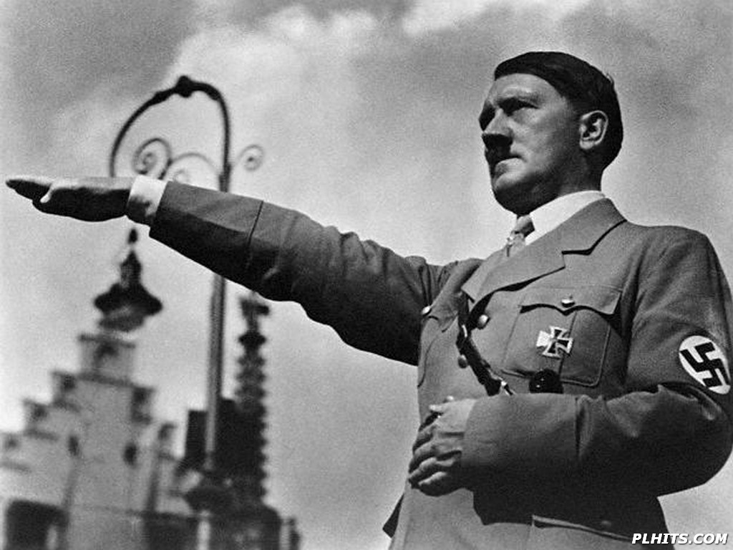

Slide 2
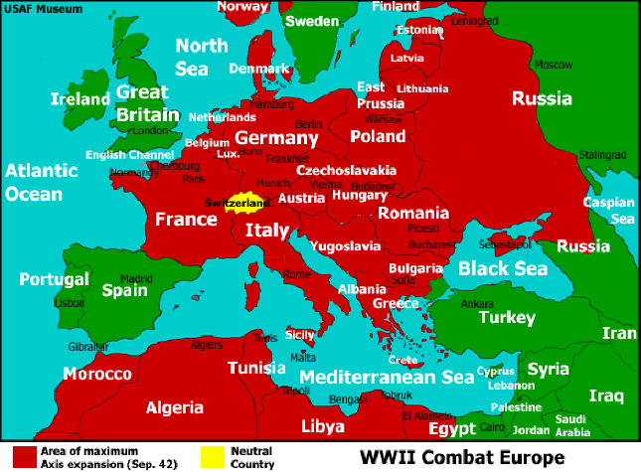

Slide 3
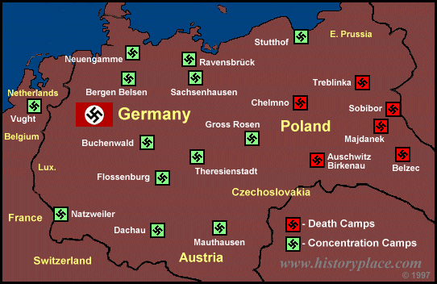

Slide 4
All over the world, Auschwitz has become a symbol of terror, genocide, and the Holocaust. It was established by the Nazis in 1940, in the suburbs of Oswiecim, a Polish city that was annexed to the Third Reich by the Nazis. Its name was changed to Auschwitz, which also became the name of Konzentrationslager Auschwitz. The camp was established in mid-1940, more than a year before the Germans embarked upon the "Endlösung der Judenfrage" (Final Solution of the Jewish Question) - the plan, systematically carried out, to murder all the Jews living in the countries occupied by the Third Reich. The direct reason for the establishment of the camp was the fact that mass arrests of Poles were increasing beyond the capacity of existing "local" prisons. Initially, Auschwitz was to be one more concentration camp of the type that the Nazis had been setting up since the early 1930s. It functioned in this role throughout its existence, even when, beginning in 1942, it also became the largest of the death camps.

Slide 5
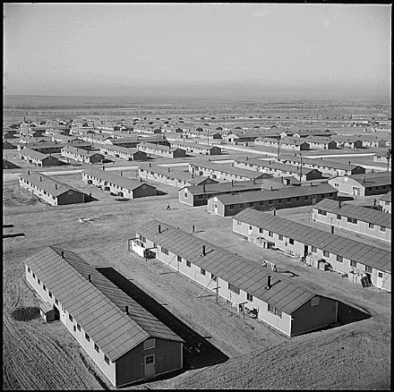

Slide 6
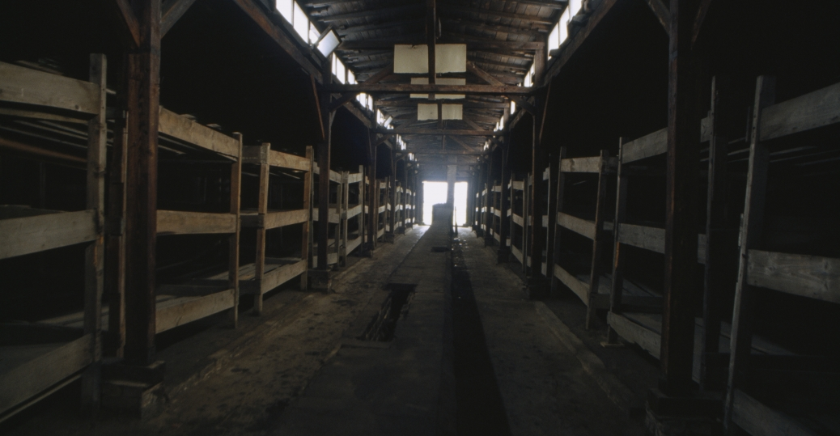

Slide 7
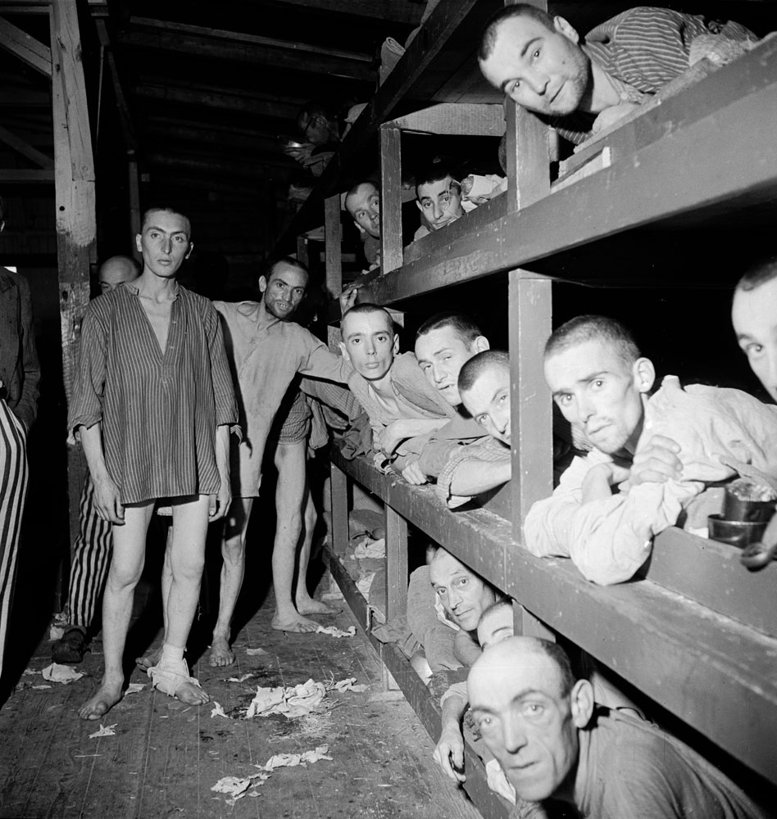

Slide 8
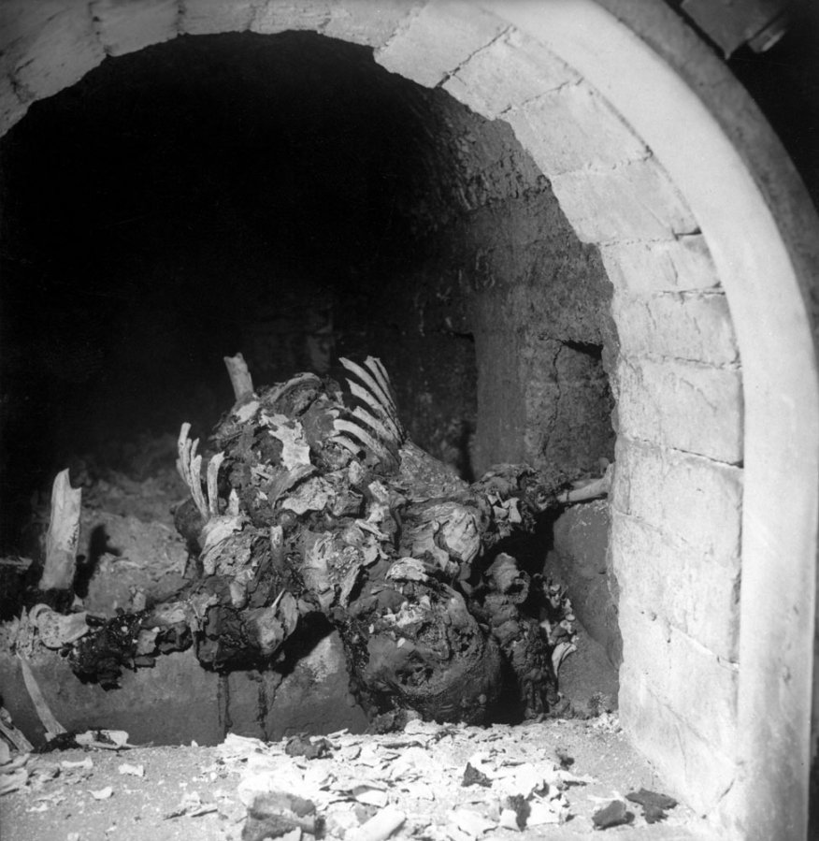

Slide 9
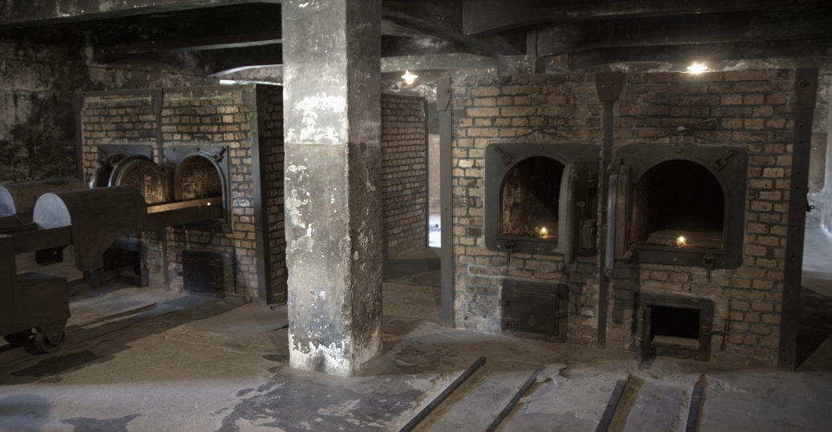

Slide 10
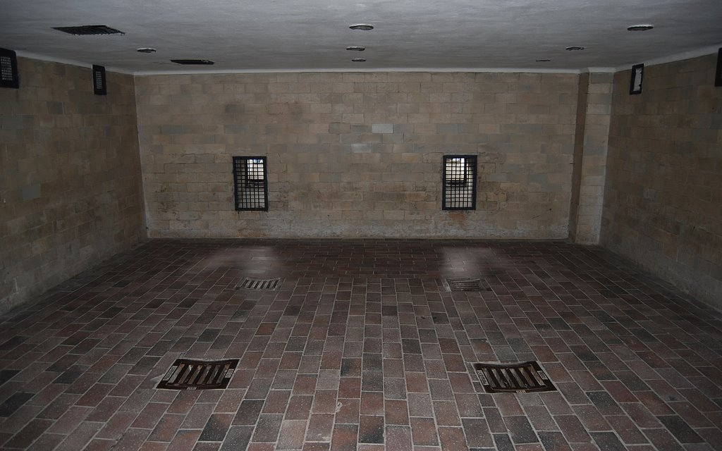

Slide 11
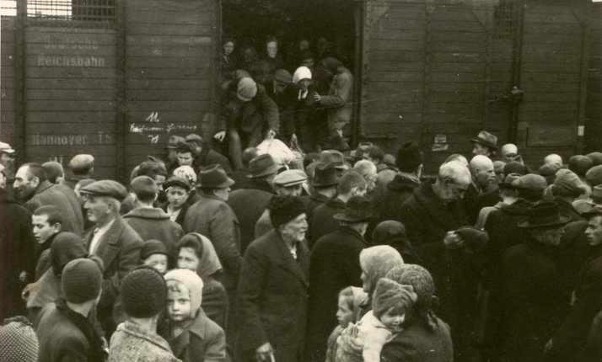

Slide 12
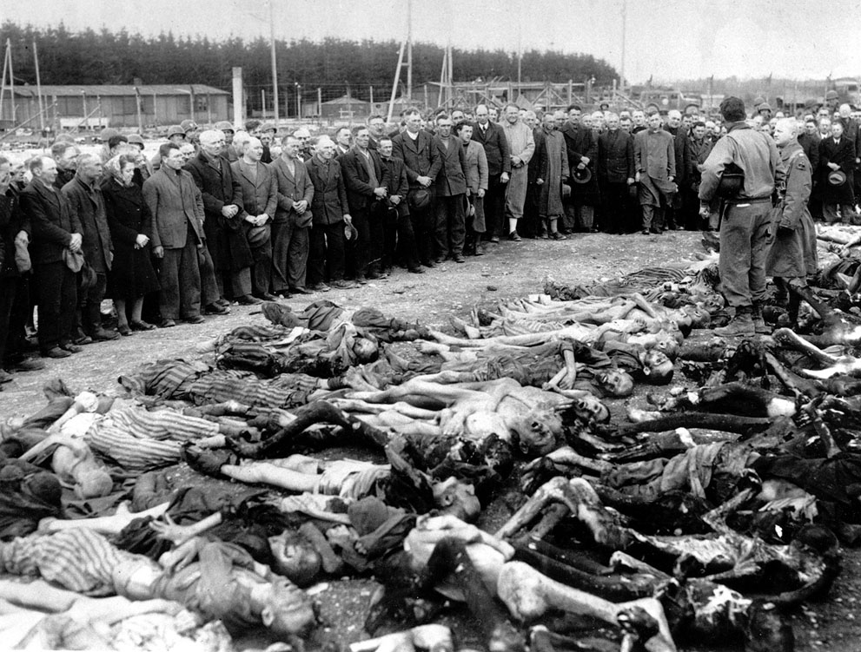

Slide 13
