Slide 2
Prussia
Weimar Republic
Goths
Saxons
Federalism
Teutonic
Franks
Charlemagne
Hansiatic League
Feudalism
Gaul
Kaiser
Hohenstaufen dynasty
Hohenzollern
Alsace-Lorraine

Slide 3
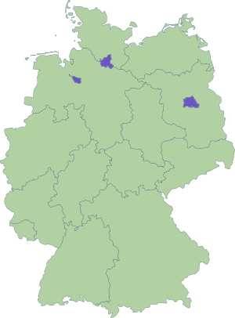

Slide 4
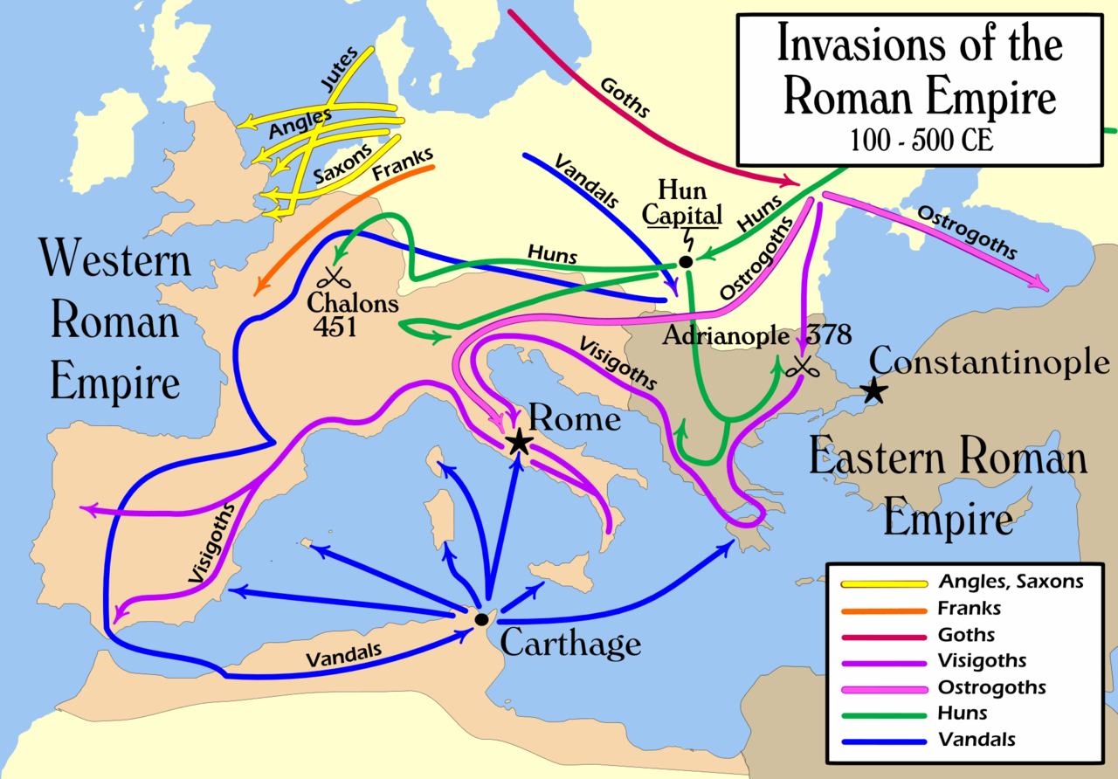

Slide 5
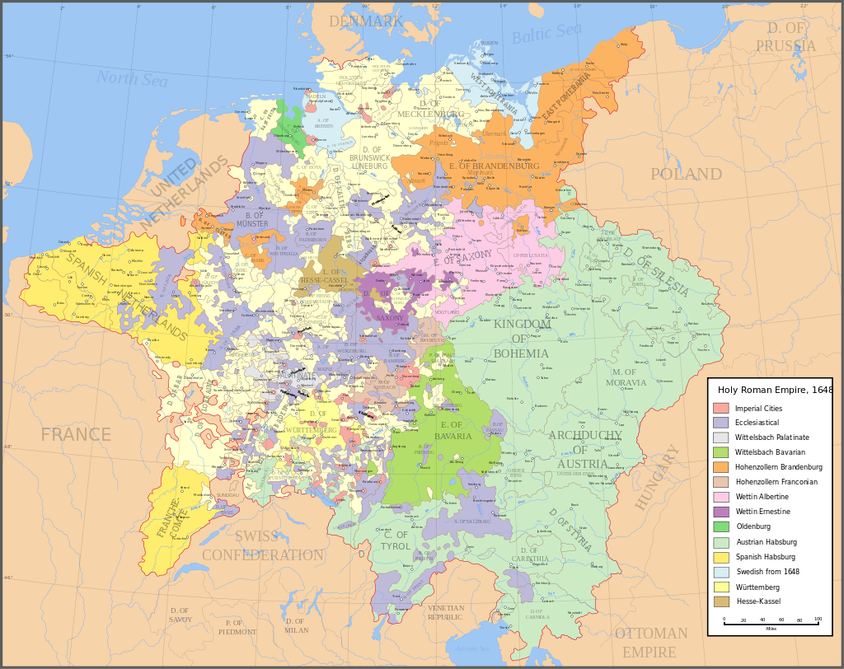

Slide 6
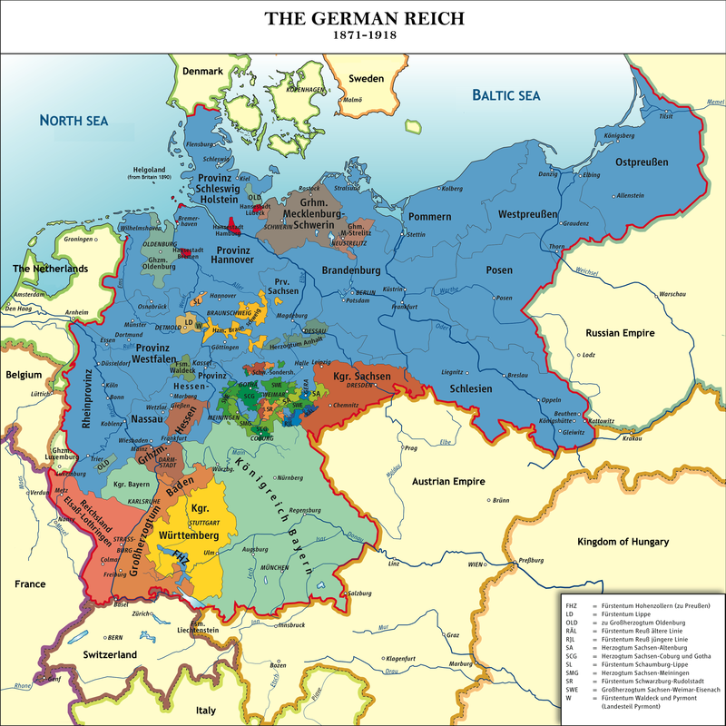

Slide 7
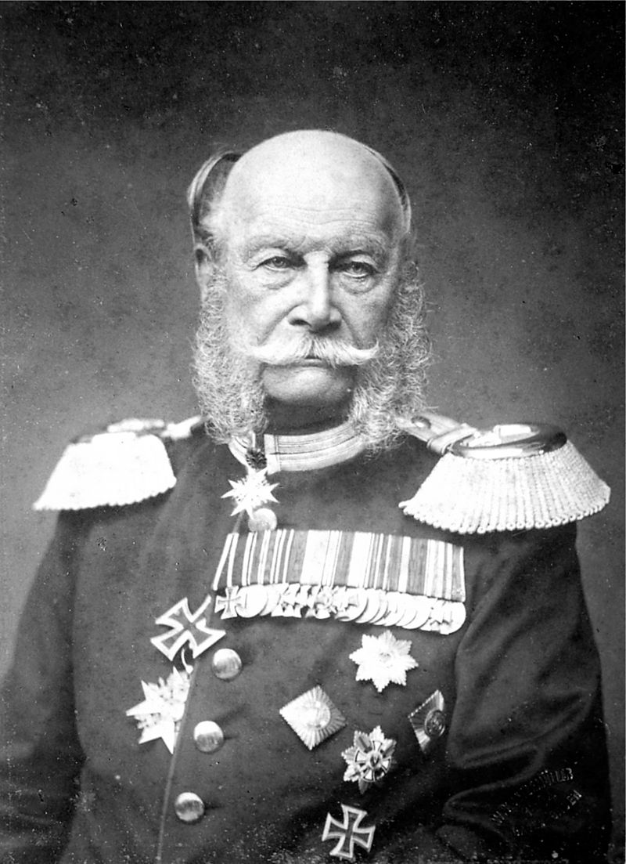

Slide 8
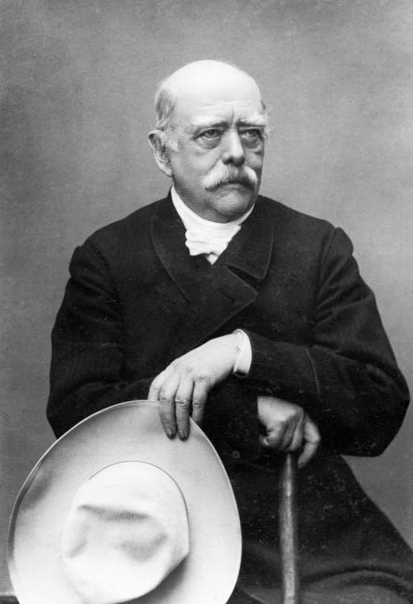

Slide 9
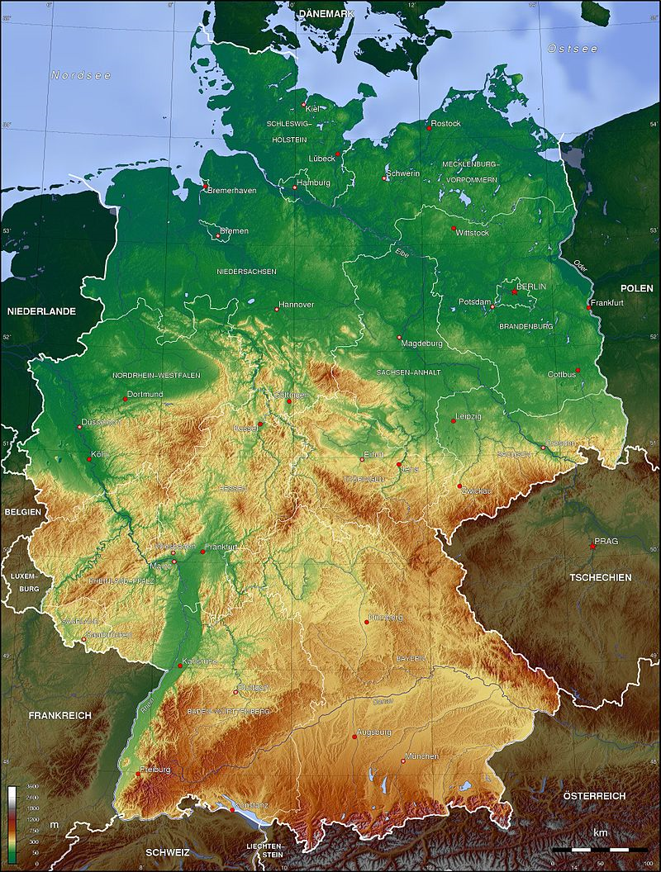

Slide 10
